Slide 1
Background
Multi-center studies are increasingly necessary to advance psychiatric neuroscience and evaluate novel interventions for patients with schizophrenia. However, successfully translating results even from large, well-powered cohorts to usual-care clinical contexts remains challenging.
Race, ethnicity, and gender disparities in recruitment of patients with schizophrenia (SZ) may contribute to limitations in generalizing results. Here, we report on 1) race, ethnicity and gender diversity in the Consortium on the Genetics of Schizophrenia 2 (COGS2) study, and 2) quantify the extent of additive sampling necessary to achieve racial, ethnicity, and gender parity with respect to background demographics for source cities..

Slide 2
Methods
The analysis cohort included 1062 healthy control subjects (HCS) and 1415 SZ subjects between ages 18 and 65 from five COGS2 sites in: Los Angeles, New York, Philadelphia, San Diego, and Seattle. We generated a Diversity Index using methodology from National Equity Atlas and previously published entropy index calculation to characterize the diversity within this sample. We categorized subjects into 24 categories based on combinations of race (Caucasian Americans, African-American, American Indian/Alaska Native, Asian, Pacific Islander/Native Hawaiian, and Multiracial/Other), ethnicity (Hispanic/Latino or non-Hispanic/Latino), and gender (Male/Female) from demographic information assessed at study entry and generated Diversity Index values for both HCS and SZ subjects for each city. These proportions and Diversity Indexes were compared to age-matched American Community Survey (ACS) census data for each of the above cities from 2010-2014. We carried out a simulation algorithm which sequentially expanded the COGS2 cohort by 50% by randomly resampling from the already recruited cohort, excluding subjects who were already oversampled in COGS2 based ACS data. The algorithm was allowed to resample until all 24 category proportions were within 2.5% of ACS data, and simulations were repeated 1,000 times.

Slide 3
Methods revision
The analysis cohort included 1062 healthy control subjects (HCS) and 1415 SZ subjects between ages 18 and 65 from five COGS2 sites in: Los Angeles, New York, Philadelphia, San Diego, and Seattle.
We categorized subjects into 24 categories based on combinations of 6 races (Caucasian Americans, African-American, American Indian/Alaska Native, Asian, Native Hawaiian/Pacific Islander, and Multiracial/Other), 2 ethnicities (Hispanic/Latino or non-Hispanic/Latino), and 2 genders (Male/Female) from demographic information assessed at study entry for both HCS and SZ subjects for each city. Below are the mappings between the races and their corresponding acronyms.
These proportions were compared to age-matched American Community Survey (ACS) census data for each of the above cities from 2010-2014. P-values from these binomial comparisons were adjusted using the Holm method for multiple comparisons. We carried out a simulation algorithm which sequentially expanded the COGS2 cohort by 50% by randomly resampling from the already recruited cohort, excluding subjects who were already oversampled in COGS2 based ACS data. The algorithm was allowed to resample until all 24 category proportions were within 2.5% of ACS data, and simulations were repeated 1,000 times.

Slide 4
Table of Race Acronyms
Race | Acronym
African-American | AA
American Indian/Alaska Native | AE
Asian | AS
Caucasian | CA
Native Hawaiian/Pacific Islander | NH
Multiracial/Other | OT/UNK

Slide 5
Discussion
Data highlights the extent to which both HCS and SZ subjects differ in demographic composition compared to the city populations in which they are recruited. While demographic discrepancies have been observed in many large multi-site SZ trials, our results suggest relying on usual recruitment and ascertainment strategies would be inadequate for achieving demographic parity: COGS2 would need to be expanded by a median factor of >3 for HCS and >25 for SZ to achieve representative racial, ethnic, and gender diversity. Ongoing analyses will investigate whether primary outcomes in COGS2 would be altered in simulated cohorts which are adequately diverse. Our findings emphasize the need for nuanced and targeted approaches for recruitment in large SZ multi-site studies.

Slide 6
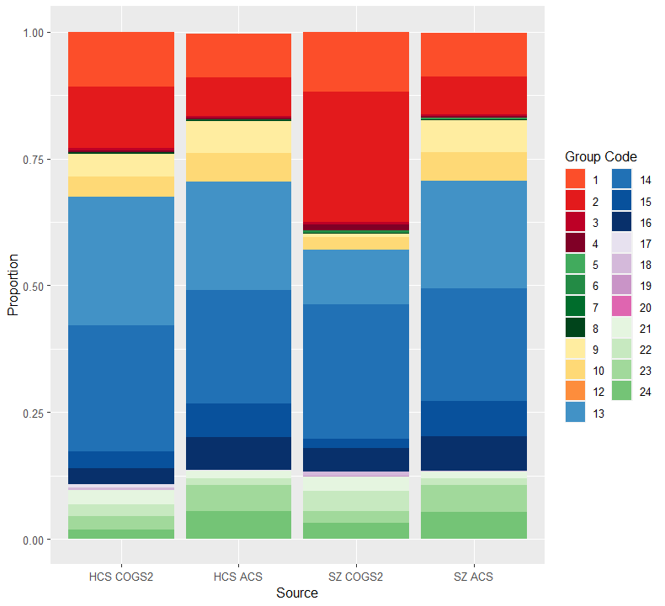
Figure 1: COGS2 and ACS Demographics

Slide 7
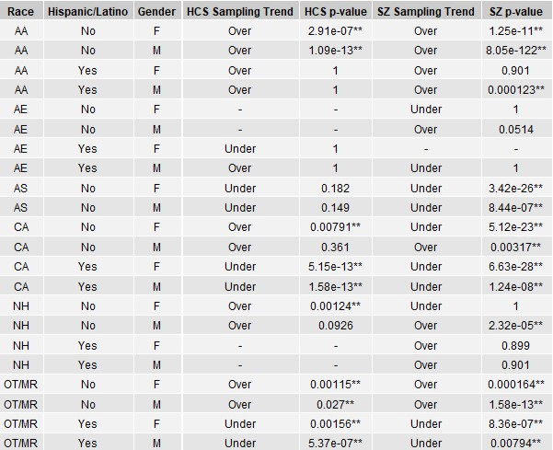
Table 1: Hypothesis Testing for Over/Underrepresentation

Slide 8
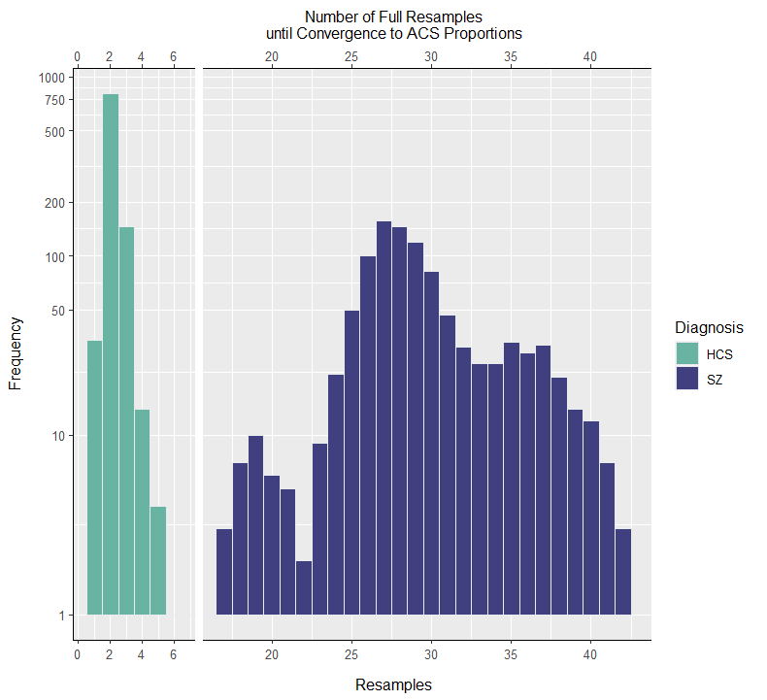
Figure 2: HCS and SZ Simulation Results

Slide 9
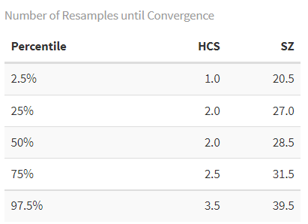
Table 2: Simulation Results- Percentiles

Slide 10

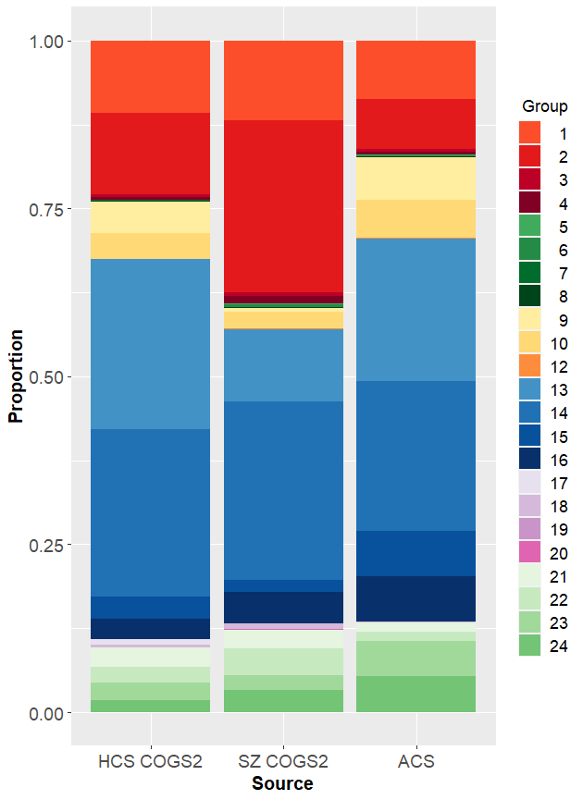
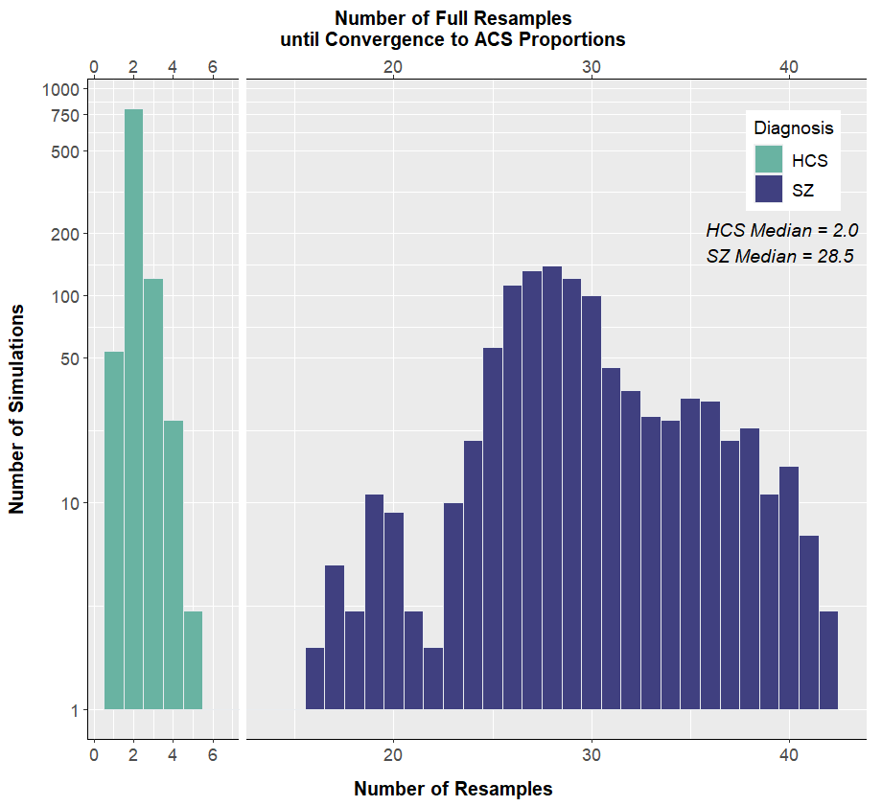
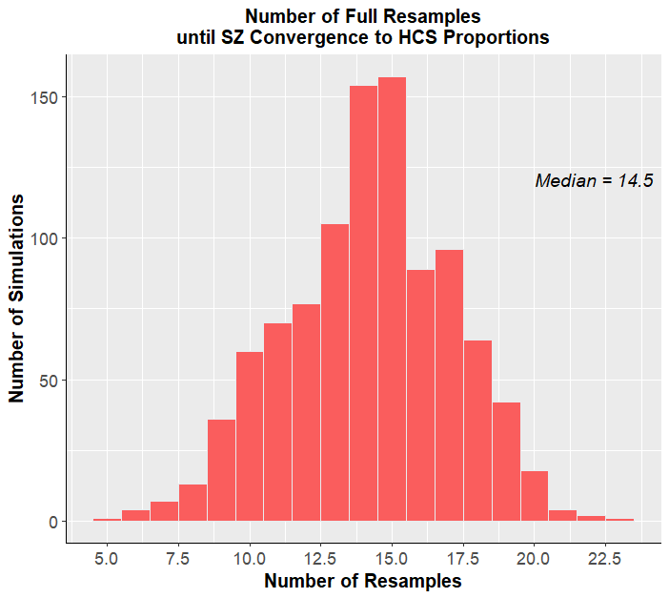
Background
Figure 1: COGS2 and ACS Demographics
Table 1: Hypothesis Testing for COGS2 Representation Compared to ACS
How diverse are large multi-site schizophrenia studies? Modelling race, ethnicity and gender parity in COGS2
Novel approach for characterizing demographic parity within multi-site psychiatry studies.
TAKE HOME POINT
Race, ethnicity, and gender disparities in recruitment of patients with schizophrenia (SZ) may create issues with generalizability. Here, we report on race, ethnicity and gender diversity in the Consortium on the Genetics of Schizophrenia 2 (COGS2) study, and quantify the extent of additive rejection sampling necessary to achieve racial, ethnicity, and gender parity, providing additional insight beyond p-values from multiple binomial comparisons or multinomial hypothesis testing.
Figure 2: Simulation Results COGS2 → ACS
Discussion
This data highlights the extent to which both HCS and SZ subjects from COGS2 differ in demographic composition compared to the city populations in which they are recruited as well as the extent of demographic difference between HCS and SZ subjects within COGS2.
While demographic discrepancies have been observed in many large multi-site SZ trials, our results suggest relying on usual recruitment strategies would be inadequate for achieving demographic parity: COGS2 would need to be expanded by a median factor of >3 for HCS and >29 for SZ to achieve representative racial, ethnic, and gender diversity. Convergence between SZ and HCS required a median expansion factor of >15, suggesting that within COGS2, the SZ sample was more closely related to HCS than the corresponding ACS population.
Ongoing analyses will investigate whether primary outcomes in COGS2 would be altered in simulated cohorts which are adequately diverse. Our findings emphasize the need for nuanced and targeted approaches for recruitment in large SZ multi-site studies.
Methods
The analysis cohort included 1062 healthy control subjects (HCS) and 1415 SZ subjects between ages 18 and 65 from five COGS2 sites in: Los Angeles, New York, Philadelphia, San Diego, and Seattle.
We categorized subjects into 24 categories based on combinations of 6 races (Caucasian, African-American, American Indian/Alaska Native, Asian, Native Hawaiian/Pacific Islander, and Other/Multiracial), 2 ethnicities (Hispanic/Latino or non-Hispanic/Latino), and 2 genders (Male/Female) from demographic information assessed at study entry for both HCS and SZ subjects for each city. Below are the mappings between the races and their corresponding acronyms.
Demographic proportions were compared to age-matched American Community Survey (ACS) census data for each of the above cities from 2010-2014. P-values from these binomial comparisons were adjusted using the Holm method for multiple comparisons.
We carried out a simulation algorithm which sequentially expanded the COGS2 HCS and SZ cohorts by 50% by randomly resampling from the already recruited cohort, excluding subjects who were already oversampled in COGS2 based ACS data. The algorithm was allowed to resample until all 24 category proportions were within 2.5% of ACS data, and simulations were repeated 1,000 times. The same algorithm was applied to characterize the demographic differences between SZ and HCS samples within COGS2.
Figure 3: Simulation Results SZ → HCS
References
Steven Ruggles, Sarah Flood, Matthew Sobek, Danika Brockman, Grace Cooper, Stephanie Richards, and Megan Schouweiler. IPUMS USA: Version 13.0 [dataset]. Minneapolis, MN: IPUMS, 2023. https://doi.org/10.18128/D010.V13.0
Yash B. Joshi, Daniel E. Zoleikhaeian, Juan L. Molina, COGS2 Investigators, David L. Braff, Neal R. Swerdlow, Gregory A. Light

